Slide 1
Design of Reflection Microscopy with different lenses as objective lens

Slide 2
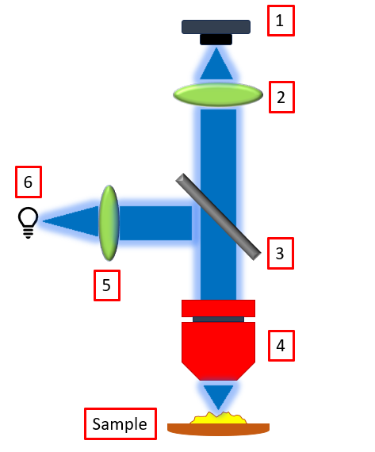
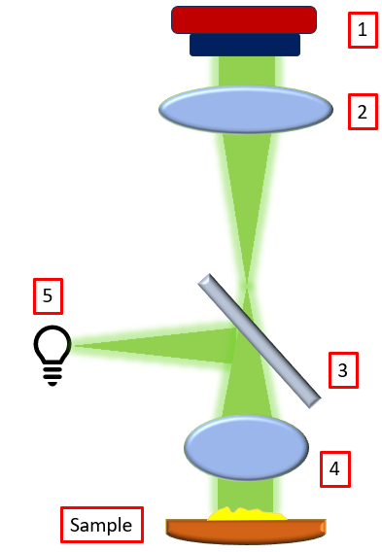
Layout 1
Layout 2
Smartphone camera as detector
Plano-convex lens as Tube lens
Beam splitter 70:30 (R:T) BST10
Microscope objective
Collimating lens
LED as light source
Smartphone camera
Plano-convex lens
Beamsplitter 70:30 (R:T) BST10
Achromatic doublet or Ball lens
LED as light source

Slide 3
 | First Layout |  | Second Layout
1 | Smart Phone Camera as detector | 1 | Smart Phone Camera as detector
2 | Plano-convex lens as tube lens (D= 6 mm, f= 11 mm) (#37-775) | 2 | Plano-convex lens as tube lens (D= 6 mm, f= 11 mm) (#37-775)
3 | Beamsplitter 70:30 (R:T) (BST10, Thorlabs) or (#45-314, Edmund Optics) | 3 | Beamsplitter 70:30 (R:T) (BST10, Thorlabs) or (#45-314, Edmund Optics)
4 | Microscope Objective RMS10X, Thorlabs | 4 | Ball lens (d= 3mm) (#43711, EO) or Achromatic doublet lens (d= 4 mm, f= 6 mm) (#63–714, EO)
5 | Collimating lens (PCX #45-083 EO) or (LA1576 Thorlabs) | 5 | 1W LED as light source
6 | 1W LED as light source

Slide 4
 | Mount | Source
Beamsplitter | KCB1C for BST10, Thorlabs | https://www.thorlabs.com/right-angle-kinematic-mirror-mounts-for-30-mm-cage-systems
Microscope objective (RMS10X, Thorlabs) | KM100R | https://www.thorlabs.com/kinematic-microscope-objective-mount
Plano-convex lens | (a) 64-555 for (45-083 ,f=12 mm, d= 12mm) (b) 64-552 for (37-775 , f= 11mm, d= 6mm) | https://www.edmundoptics.in/p/120mm-optic-diameter-optic-mount/19267/ https://www.edmundoptics.in/p/60mm-optic-diameter-optic-mount/19264/
Achromatic doublet lens | AC050-008-A-ML 63–714 | https://www.thorlabs.com/mounted-achromatic-doublets-ar-coated-400---700-nm Not found
Ball lens | Not found
Power supply | USB-OTG cable or 9V battery with battery snapper and resistor

Slide 5
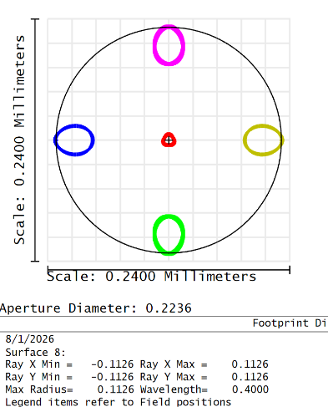
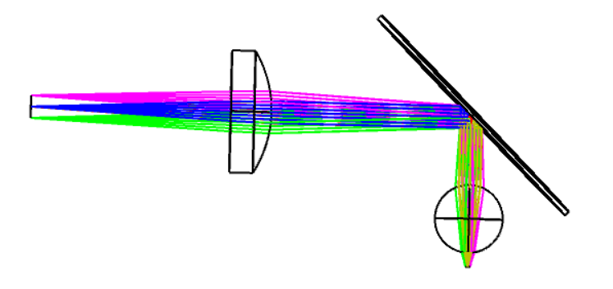
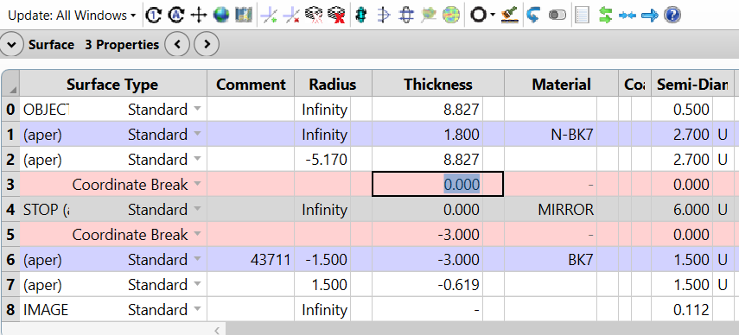
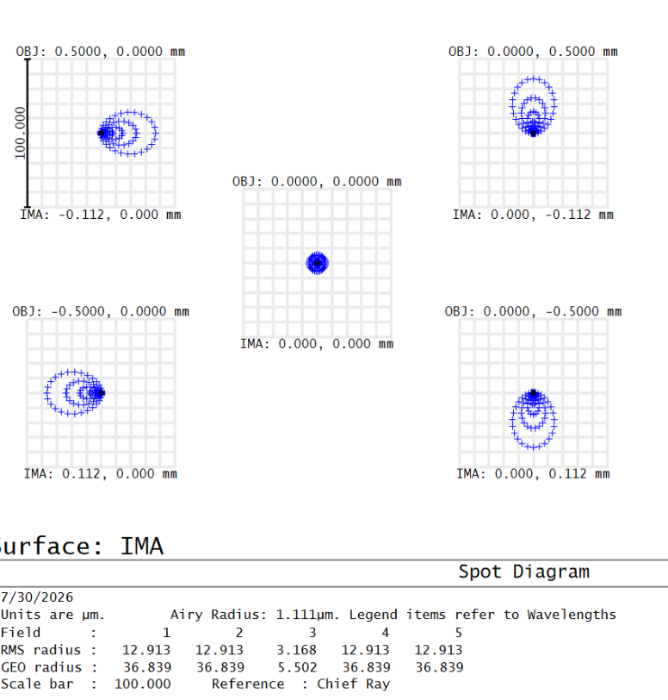
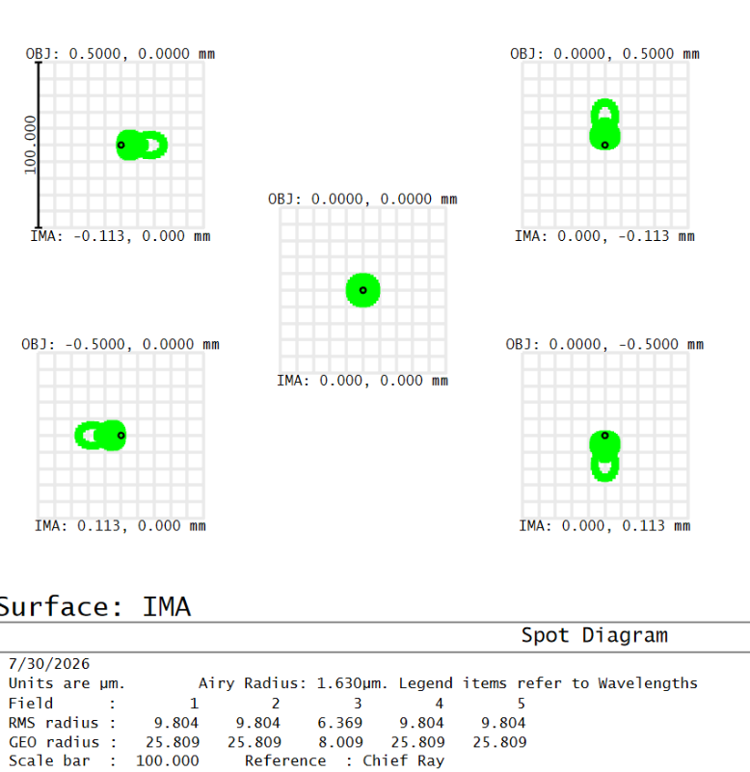
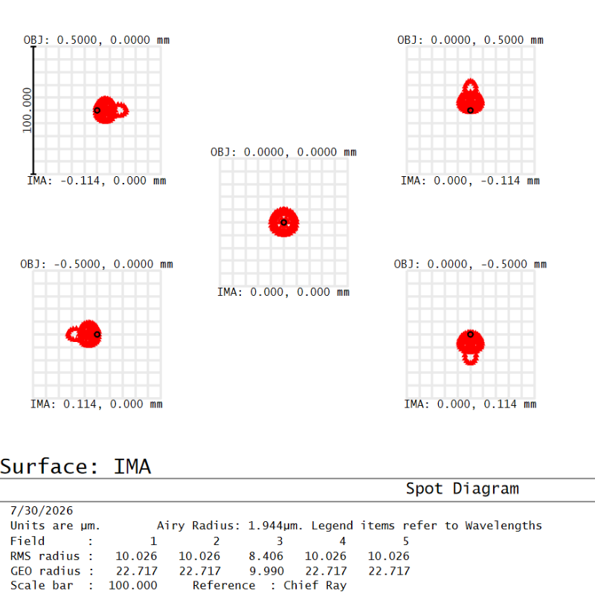
Design with Ball Lens as objective
Fig (a) 2D Layout
Fig (b) Lens Data Editor
Fig (f) Footprint diagram
Fig: Spot diagram of wavelength (c) 400 nm (d) 587 nm (e) 700 nm

Slide 6
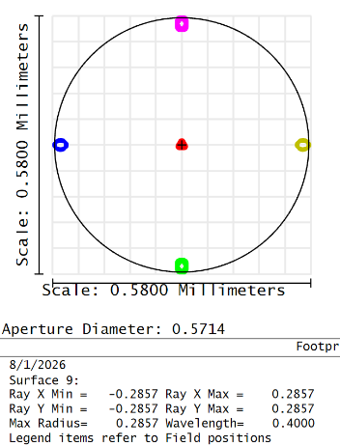
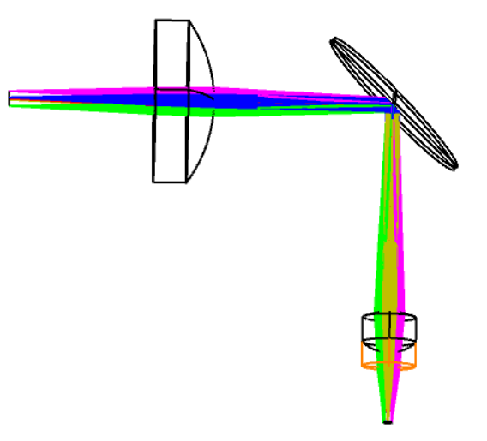
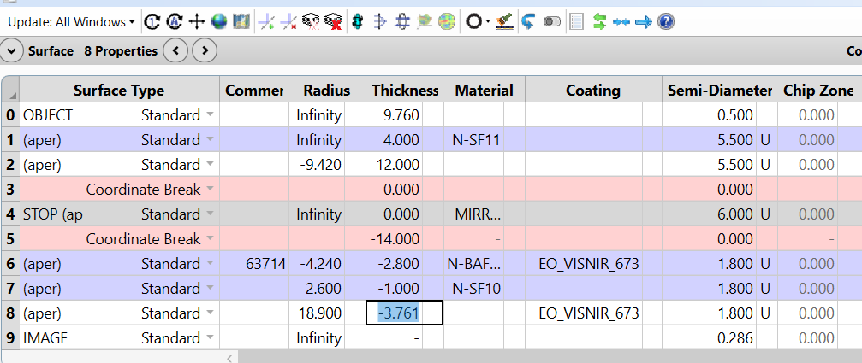
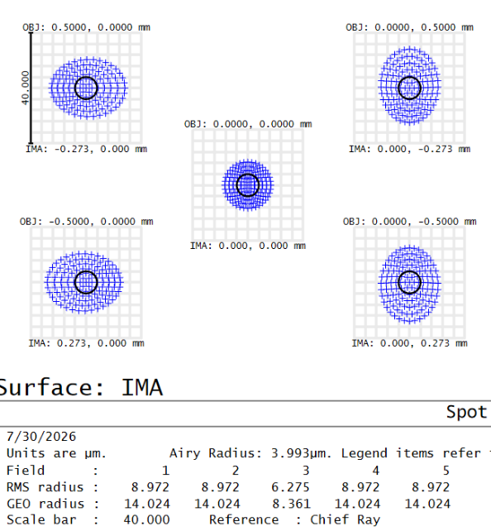
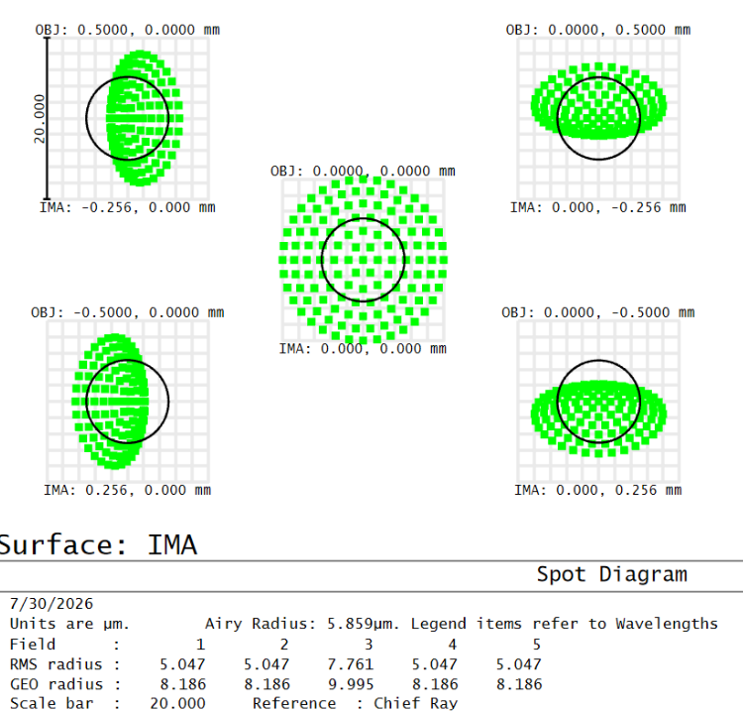
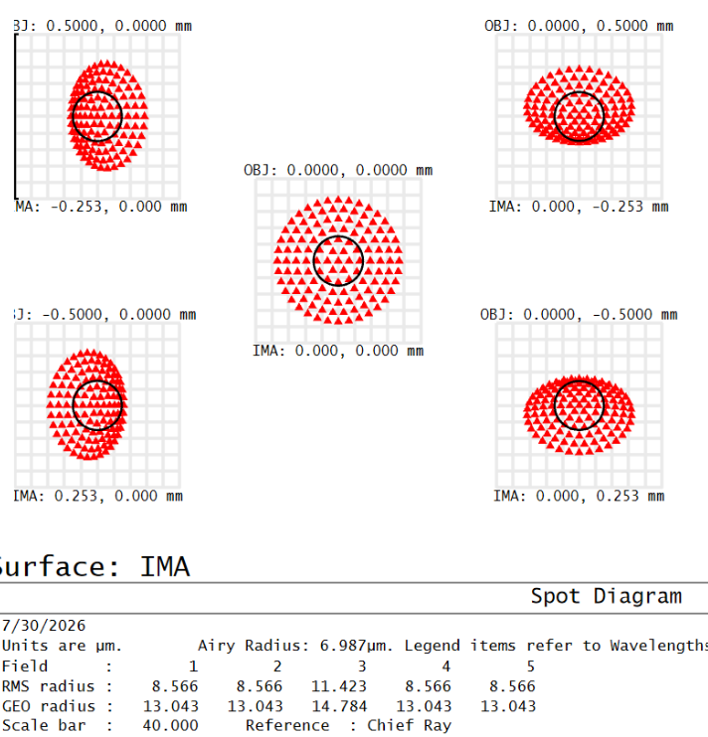
Design with Achromatic Lens
Fig (a) 2D Layout
Fig (b) Lens Data Editor
Fig (f) Footprint diagram
Fig: Spot diagram of wavelength (c) 400 nm (d) 587 nm (e) 700 nm

Slide 7
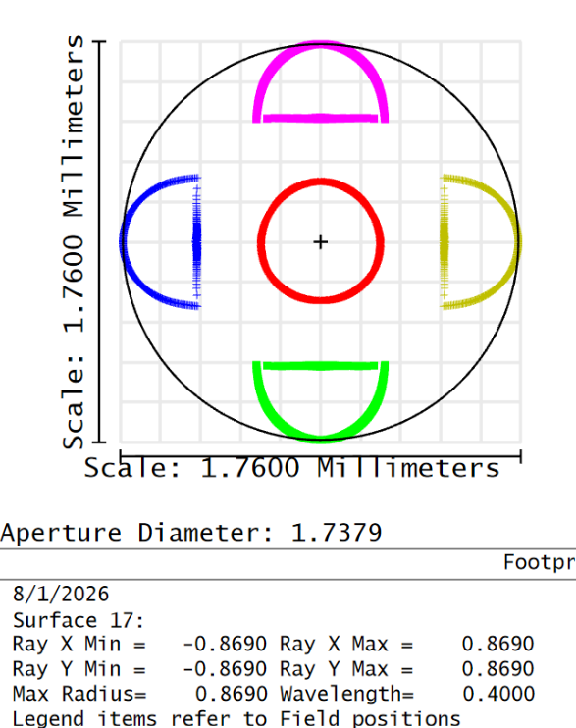
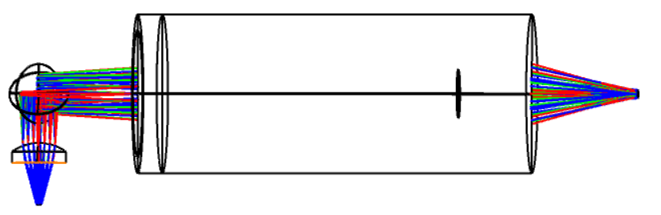
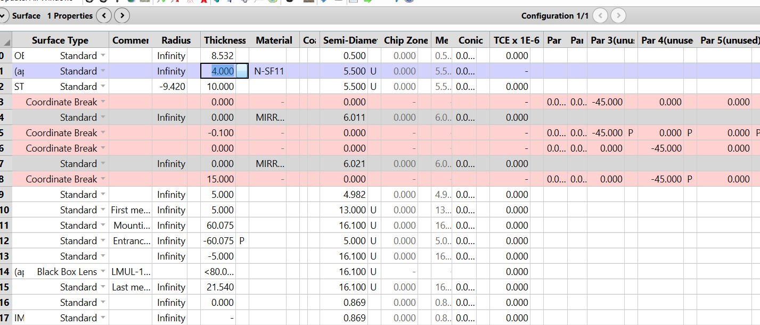
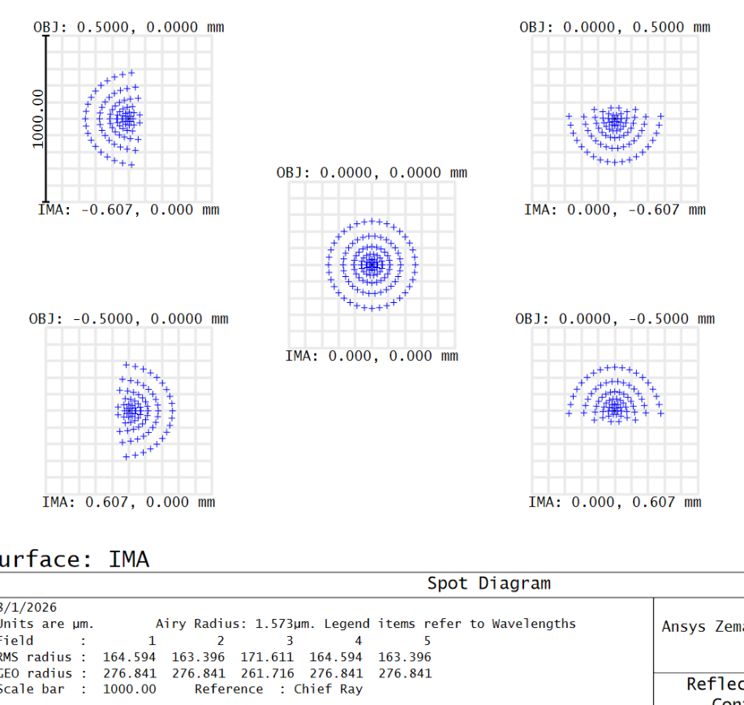
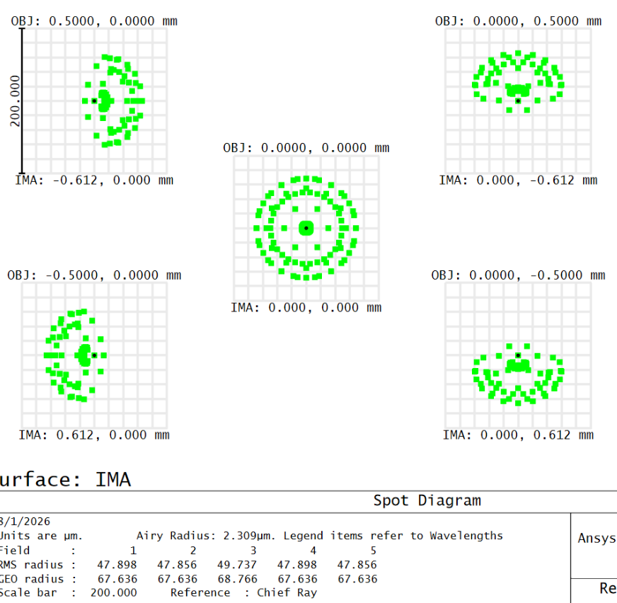
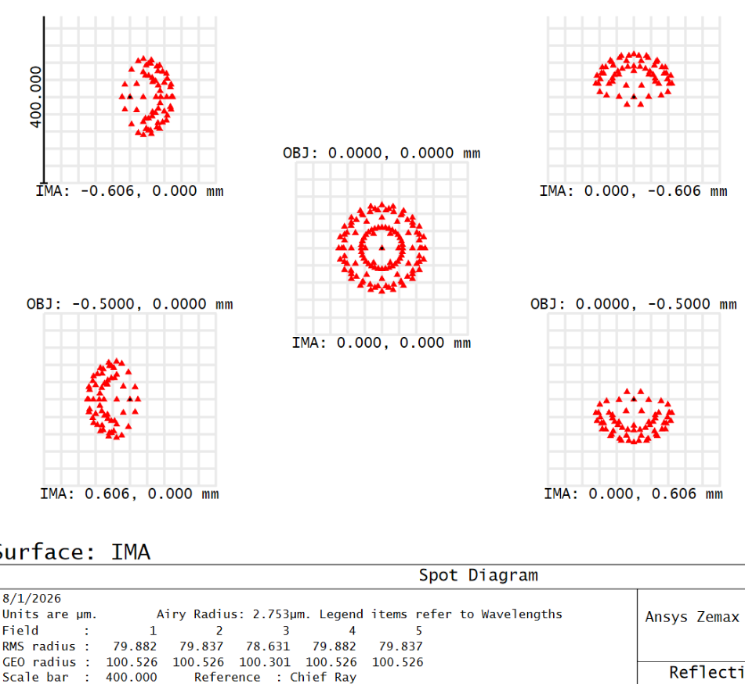
Design with Microscopic objective
Fig (a) 2D Layout
Fig (b) Lens Data Editor
Fig (f) Footprint diagram
Fig: Spot diagram of wavelength (c) 400 nm (d) 587 nm (e) 700 nm

Slide 8
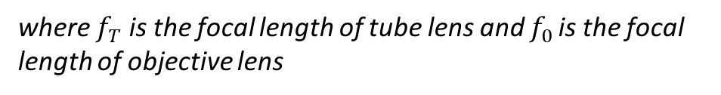

Comment
Magnification of system using ball lens as objective lens
M(total) = M1 × M2
M1 = 1000 (n −1) n/D is the magnification obtained from the ball lens where n is the refractive
index and D is the diameter of the ball lens and M2 = 1 + d /f is the magnification due to the PCX lens used.
M(total) = 171x
2. Magnification of system using achromatic lens as objective lens
$$M=\frac{f_{T}}{f_{0}}= \frac{11}{6 }=1.83x,$$
where $f_{T}$ is the focal length of tube lens and $f_{0 }$is the focal length of objective lens

Slide 9
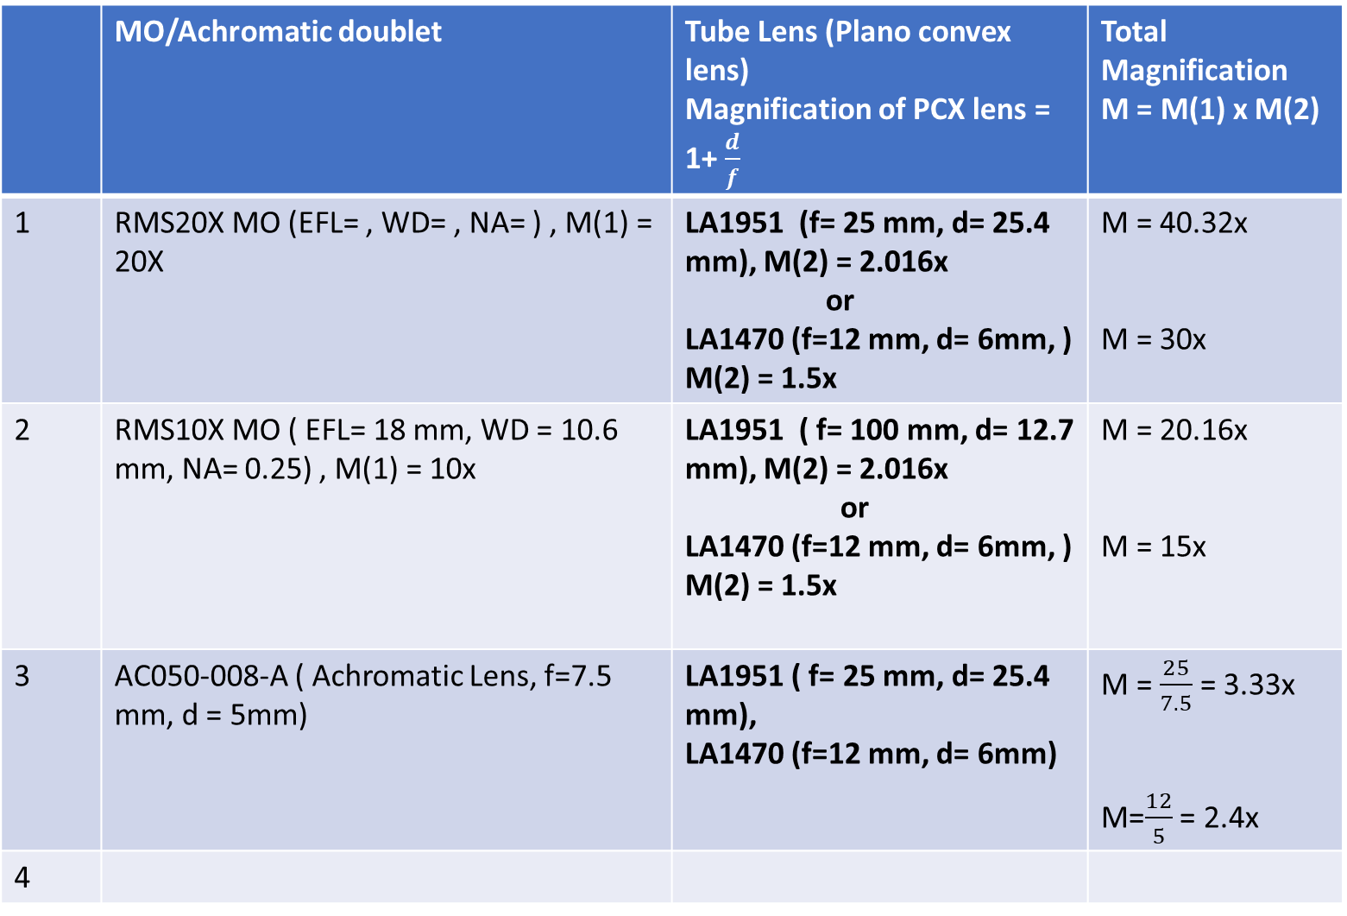
 | MO/Achromatic doublet | Tube Lens (Plano convex lens) Magnification of PCX lens = 1+ $\frac{d}{f}$ | Total Magnification M = M(1) x M(2)
1 | RMS20X MO (EFL= , WD= , NA= ) , M(1) = 20X | LA1951 (f= 25 mm, d= 25.4 mm), M(2) = 2.016x or LA1470 (f=12 mm, d= 6mm, ) M(2) = 1.5x | M = 40.32x M = 30x
2 | RMS10X MO ( EFL= 18 mm, WD = 10.6 mm, NA= 0.25) , M(1) = 10x | LA1951 ( f= 100 mm, d= 12.7 mm), M(2) = 2.016x or LA1470 (f=12 mm, d= 6mm, ) M(2) = 1.5x | M = 20.16x M = 15x
3 | AC050-008-A ( Achromatic Lens, f=7.5 mm, d = 5mm) | LA1951 ( f= 25 mm, d= 25.4 mm), LA1470 (f=12 mm, d= 6mm) | M = $\frac{25}{7.5}$ = 3.33x M=$\frac{12}{5}$ = 2.4x
4

Slide 10
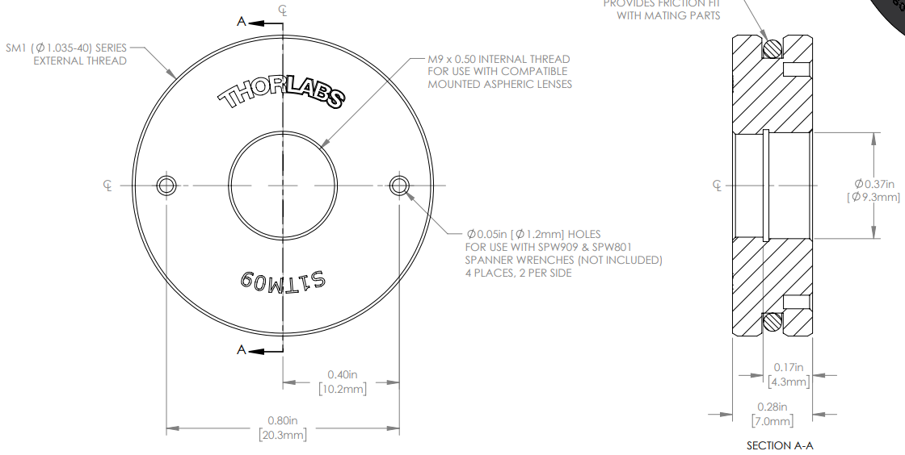
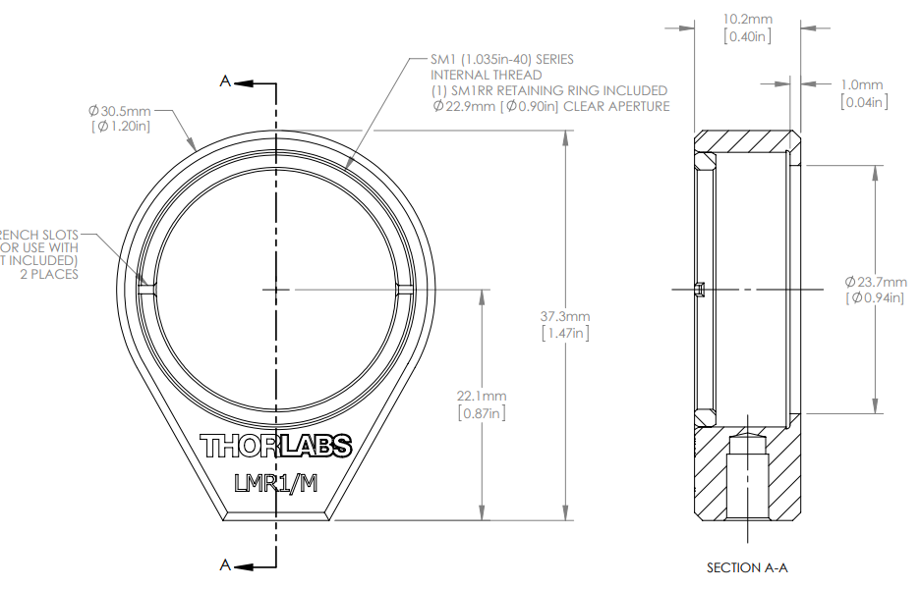
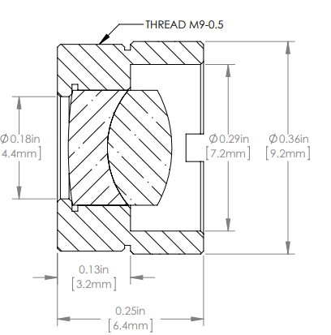
(1) AC050-008-A Holder: A lens adapter S1TM09 need to be used to fit inside the LMR1/M
S1TM09
LMR1/M
https://www.thorlabs.com/item/AC050-008-A-ML
https://www.thorlabs.com/item/LMR1_M
Physical dimension of Mounted AC05-008-A lens
https://www.thorlabs.com/item/S1TM09

Slide 11
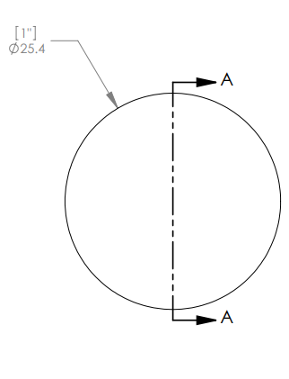
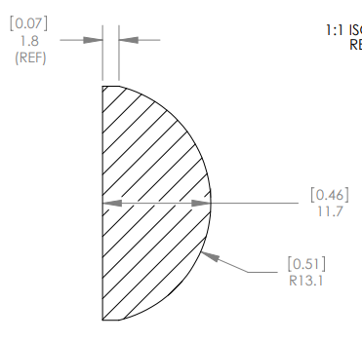
(2) LA1951 holder : The compatible lens mount for LA1951 is LMR1/M with SM1RRC retaining ring
https://www.thorlabs.com/item/LA1951
https://www.thorlabs.com/item/LMR1_M

Slide 12
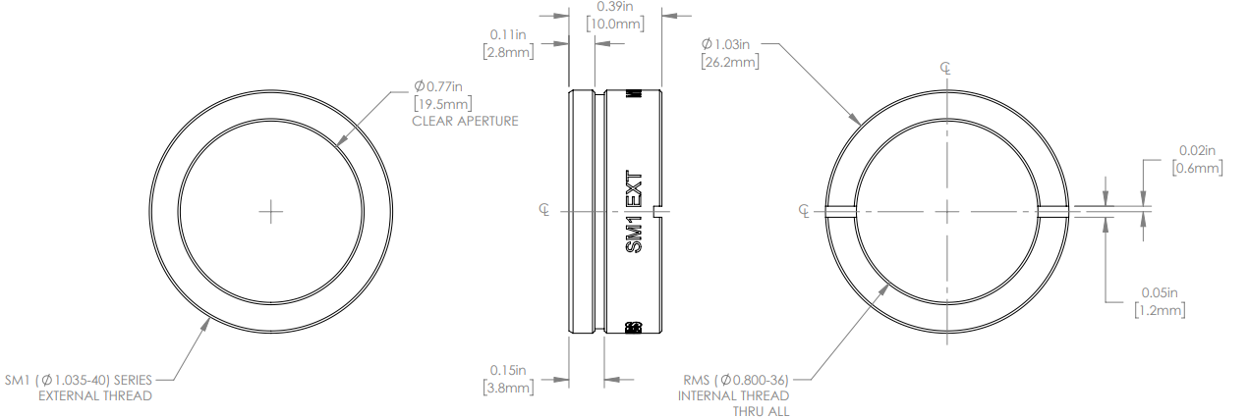
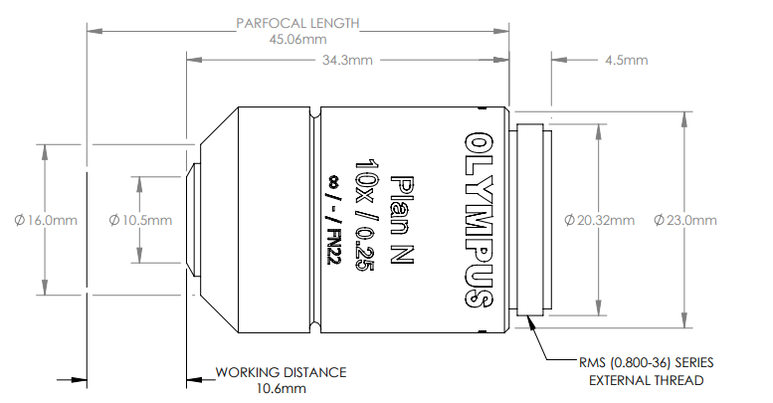
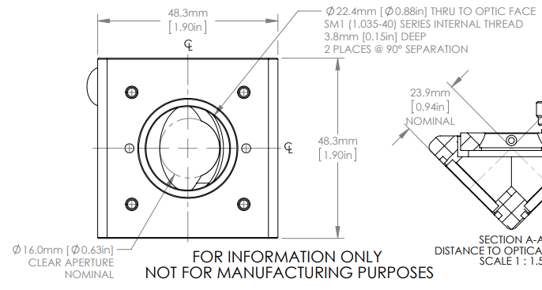
(3) RMS10X or RMS20X holder: To hold a microscope objective with a beamsplitter at 45 deg a microscope adapter M1RMSS
need to be screw with KCB1/M
Dimension of M1RMSS
https://www.thorlabs.com/item/M1RMSS
Dimension of KCB1/M
https://www.thorlabs.com/item/KCB1_M
Dimension of RMS10X
https://www.thorlabs.com/item/RMS10X

Slide 13
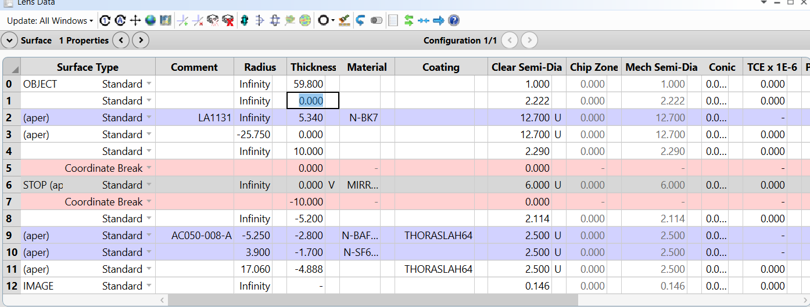
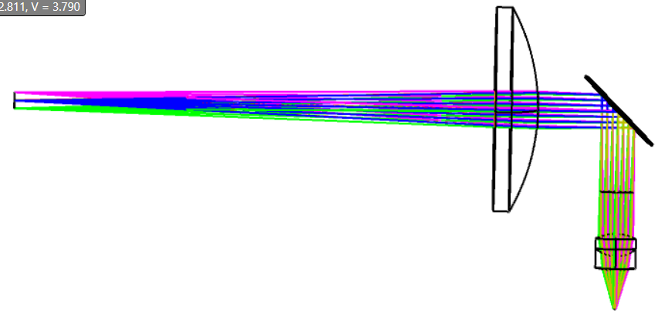
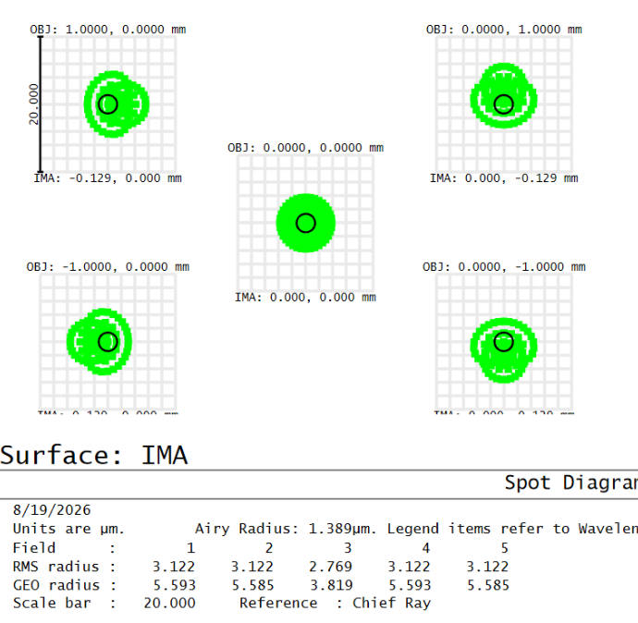
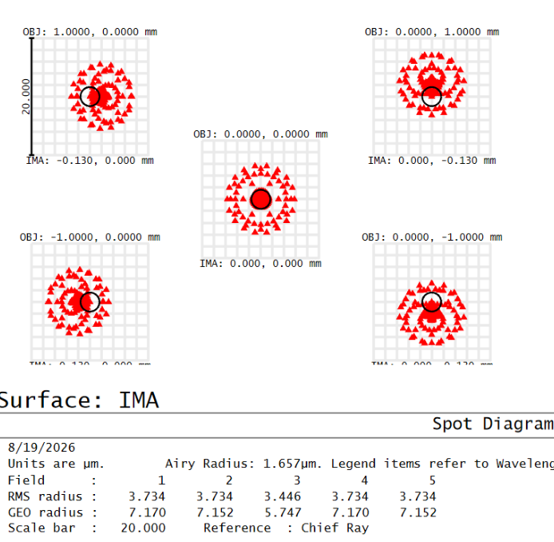
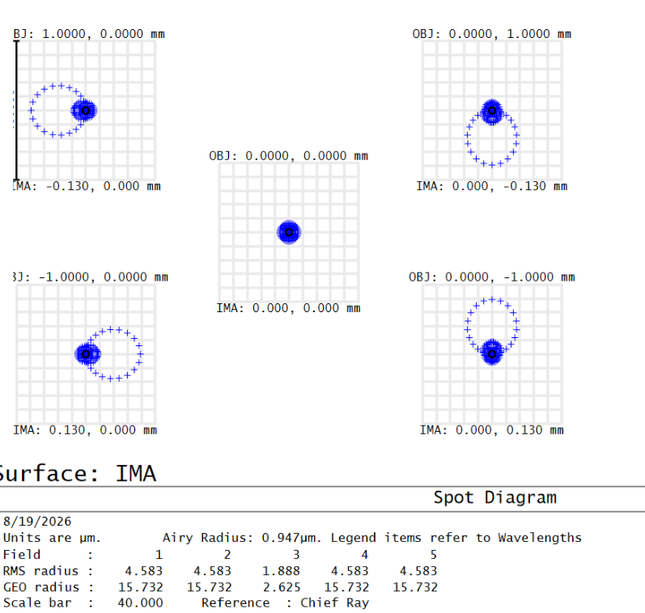
LA1134 Plano convex lens of diameter 25.4 mm and focal length 59.8 mm can be used as collimater to collimate the light beam from light source (https://www.thorlabs.com/item/LA1134 ), any other small focal length produce large beam and some light beam gets clipped from AC050-008-A and for higher focal length , the f number will be large so numerical aperture small and small cone of light beam will collect the collimating lens.

Slide 14
Smartphone based Microscopic system equivalent optical elements
LA1540 as collecting lens d=12.7mm, f= 14.9 mm
Mount: LMR05/M https://www.thorlabs.com/item/LMR05_M
LA1470 as tube lens d= 6mm, f= 12mm
Mount: LMRA6 (https://www.thorlabs.com/item/LMRA6 ) and LMR05/M
3. AC050-008-A as objective lens d=5mm, f= 7.5 (refer page number 10)

Slide 15
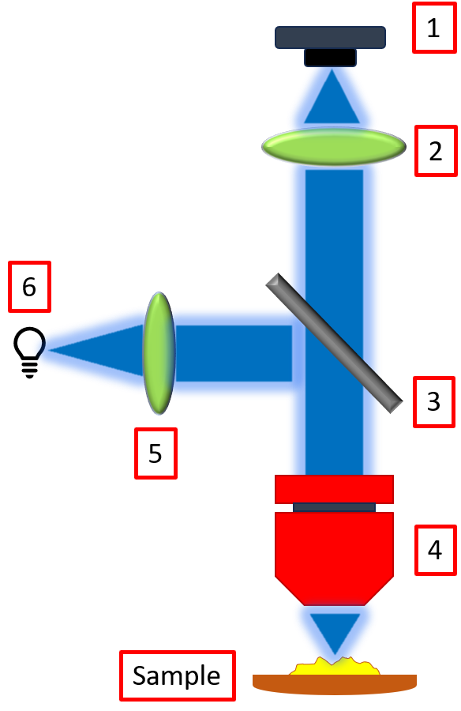
1
2
5
3
4
Sample

